Slide 1

Module Federation and Micro Frontends
An Exploration of Dynamic Module Loading in Frontend Architecture

Slide 2
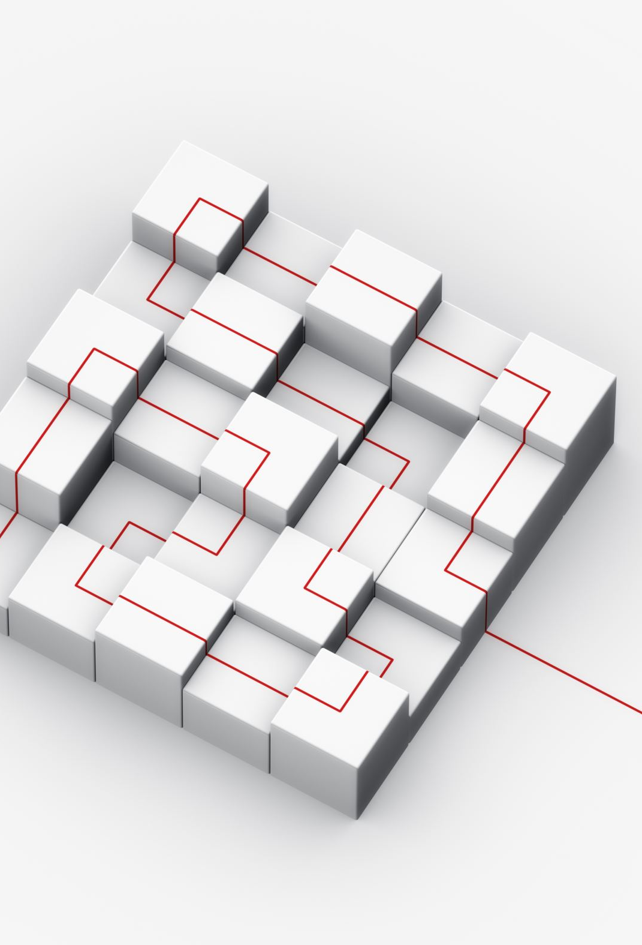
What is Module Federation
Module Federation is a concept in the context of front-end development that enables the sharing of code and resources across multiple independently deployed applications. This concept is particularly relevant in the context of micro frontends, which is an architectural approach to building front-end applications by breaking them down into smaller, independently deployable and scalable units.

Slide 3
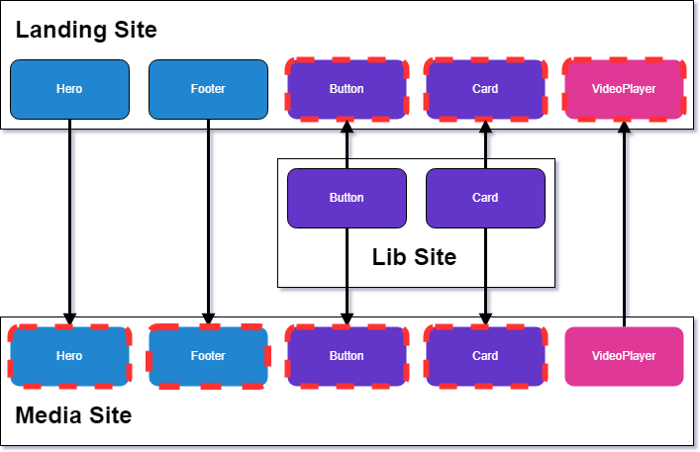
How it works
Each application exposes specific modules that other applications can consume. These modules can be dynamically loaded and executed in the consumer application, making it possible to share logic, components, and other resources across different parts of the system.

Slide 4

Relationship between Module Federation and Micro Frontends
Module Federation is a technique that can be used to implement the principles of Micro Frontends. By using Module Federation, different micro frontends can dynamically import and use modules from each other, allowing for better code sharing and collaboration between independent teams.
With Module Federation, each micro frontend can expose specific modules that other micro frontends can consume, creating a more modular and flexible front-end architecture.

Slide 5
Key Concepts of Module Federation
Remote Modules
Exposed Modules
Shared Modules

Slide 6
Remote Modules
These are independent modules or components that reside in separate codebases or repositories. They are designed to be loaded dynamically at runtime by other applications, typically referred to as host applications.
Dynamic Loading:
Remote modules are loaded on demand, meaning they are not bundled with the main application during build time. Instead, they are fetched and integrated into the host application at runtime.
Role of Dynamic Loading:
Enables a more flexible and efficient system by loading only the modules needed for a specific functionality.
Allows for updates and changes to remote modules without requiring a full application redeployment.

Slide 7
Exposed Modules
In the context of Module Federation, exposing modules means making certain components or functionalities available for consumption by other applications. This is achieved by explicitly defining which parts of a module are meant to be shared.
Selective Sharing:
Exposed modules allow developers to selectively share specific functionalities while keeping others private.

Slide 8
Shared Modules
These are modules that contain shared code, assets, or resources that can be utilized by multiple micro frontends. Shared modules promote code reusability and maintainability across the application landscape.
Code and Resource Sharing:
Shared modules facilitate the sharing of common functionalities, such as utility functions, styles, or assets, reducing duplication across micro frontends.
Version Control:
Shared modules can be versioned and updated independently, allowing for a more modular and decentralized approach to development.

